Slide 1



EARLY DETECTION OF ALZHEIMER'S DISEASE USING MOBILENET ALGORITHM: A DEEP LEARNING APPROACH

Slide 2


ABSTRACT
Alzheimer’s disease (AD) is a progressive neurodegenerative disorder that significantly impacts cognitive function, memory, and daily living. Early detection of AD is critical for timely intervention and improving the quality of life for patients. This project proposes an innovative approach to Alzheimer’s disease prediction using the MobileNet algorithm, a lightweight and efficient deep learning architecture. The MobileNet model is trained on medical imaging datasets, such as MRI or CT scans, to classify and predict Alzheimer’s disease at its early stages.
The proposed system leverages the computational efficiency of MobileNet to ensure scalability and accessibility, making it suitable for deployment on resource-constrained devices like smartphones or embedded systems. The model undergoes rigorous preprocessing and training to achieve high accuracy, robustness, and generalizability. Performance evaluation is conducted using metrics such as accuracy, precision, recall, and F1-score, demonstrating the effectiveness of the proposed solution.

Slide 3





GOALS AND OBJECTIVES
Objective n° 1
Objective n° 2
Objective n° 3
Develop an Efficient Prediction Model. Create a lightweight and robust deep learning model using the MobileNet algorithm to accurately predict Alzheimer’s disease from medical images
Enhance Early Diagnosis: Facilitate the early detection of Alzheimer’s disease to enable timely intervention and treatment
Ensure High Performance: Achieve high accuracy, sensitivity, and specificity in predicting Alzheimer’s disease to ensure reliability in clinical settings.

Slide 4


INTRODUCTION
Alzheimer’s disease (AD) is a chronic neurodegenerative disorder that primarily affects memory, cognitive functions, and behavior, ultimately interfering with daily life.
It is the most common cause of dementia worldwide and represents a significant public health challenge.
Early detection of Alzheimer’s disease is crucial, as timely interventions can slow disease progression, enhance the quality of life, and reduce healthcare costs. However, traditional diagnostic methods, such as clinical examinations and imaging, can be time-consuming, expensive, and prone to subjective interpretation.
With the advancement of artificial intelligence (AI) and deep learning, automated diagnostic tools have emerged as a promising solution for early detection of Alzheimer’s disease.

Slide 5

EXISTING
SYSTEM

Slide 6

EXISTING SYSTEM
The existing system for Alzheimer’s disease prediction utilizes the ResNet (Residual Network) architecture, a deep learning model renowned for its ability to handle very deep networks without suffering from the vanishing gradient problem.
ResNet achieves this through the use of residual connections, which allow the model to learn residual functions.
85%
The ResNet model is employed to analyze medical imaging data, such as MRI or CT scans, to predict the presence of Alzheimer’s disease.
ACCURACY

Slide 7


DISADVANTAGES
1
High Computational Complexity:
ResNet, especially deeper versions like ResNet-101, requires significant computational resources for training and inference, making it less feasible for deployment on low-resource devices.
2
Model Size:
The ResNet model, due to its deep architecture, has a large number of parameters. This results in longer training times and increased storage requirements, making it less efficient for mobile or embedded system applications.

Slide 8


DISADVANTAGES
3
Interpretability:
Despite its high accuracy, deep networks like ResNet can often lack interpretability, making it difficult for clinicians to understand how the model arrives at a diagnosis.
4
Limited Flexibility:
ResNets are less flexible in capturing complex patterns in data compared to some other machine learning models, such as neural networks, which might limit their effectiveness in complex, multi-dimensional problems like career recommendations.

Slide 9
PROPOSED
SYSTEM

Slide 10
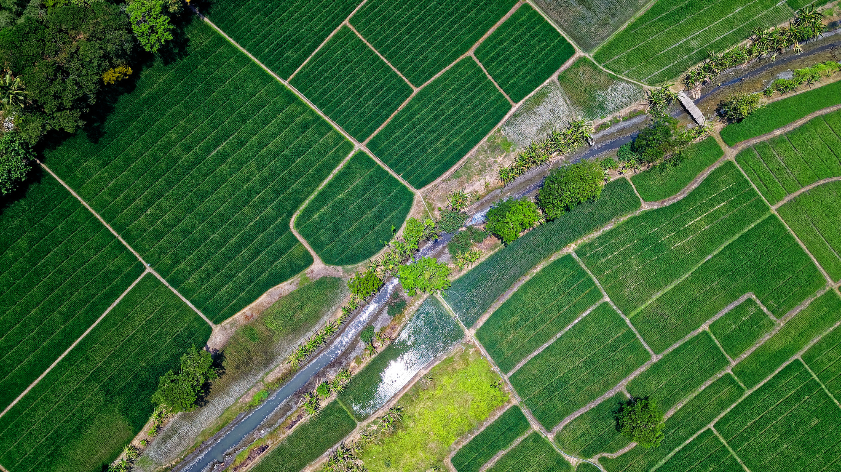
PROPOSED SYSTEM
The proposed system aims to predict Alzheimer’s disease at an early stage using the MobileNet deep learning algorithm. MobileNet, a lightweight convolutional neural network (CNN) architecture, is chosen for its computational efficiency and ability to deliver accurate results while operating on resource-constrained devices.
The system will process medical imaging data, such as MRI or CT scans, to identify patterns indicative of Alzheimer’s disease.

Slide 11

PROPOSED SYSTEM
The process begins with data collection and preprocessing, where medical images are resized, normalized, and augmented to enhance model robustness.
The MobileNet model will be pre-trained on a general image dataset and then fine-tuned using the Alzheimer’s imaging data for classification.
By extracting features from medical images, the model will classify the data into categories such as Normal, Mild Cognitive Impairment (MCI), or Alzheimer’s Disease.

Slide 12
PROPOSED SYSTEM
For system deployment, the model will be optimized for use on mobile and embedded devices, ensuring accessibility for clinicians who may not have access to high-end computing resources.
A user-friendly interface will allow clinicians to upload medical images and receive predictions with high accuracy.
This system will be evaluated using standard performance metrics, including accuracy, precision, recall, and F1-score, to ensure its effectiveness in real-world clinical settings. By integrating deep learning into the diagnostic process, this system provides a scalable, efficient, and cost-effective solution for the early detection of Alzheimer’s disease, supporting timely interventions and improving patient outcomes.

Slide 13
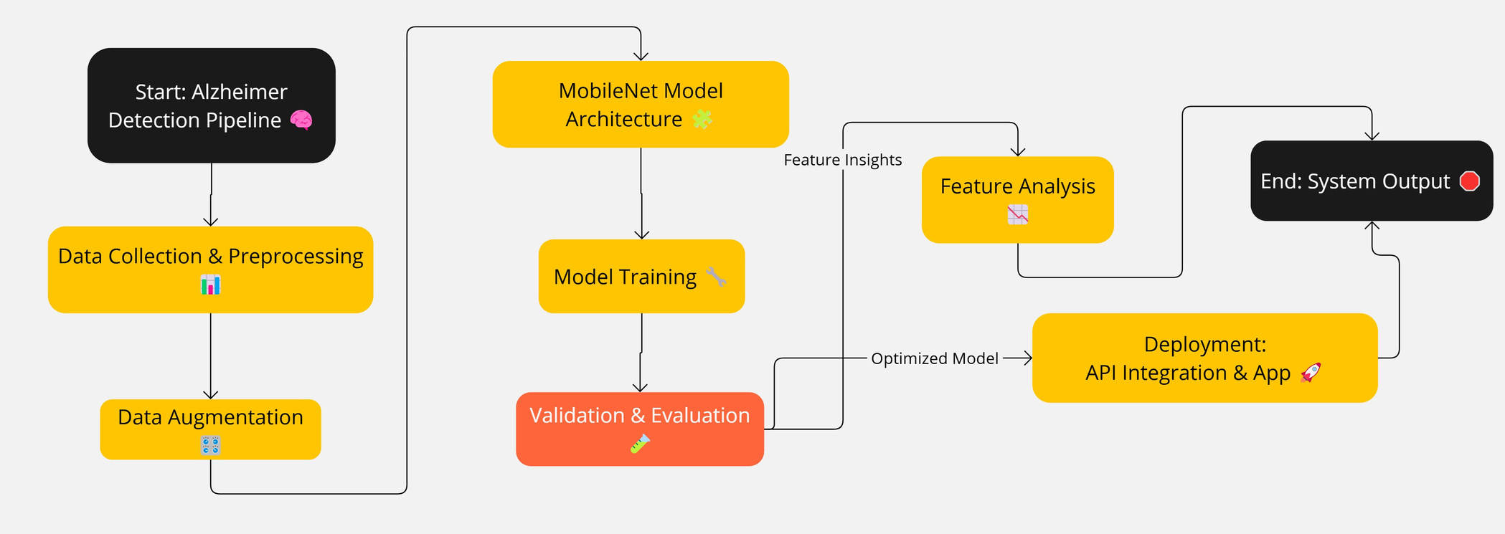
ARCHITECTURE

Slide 14
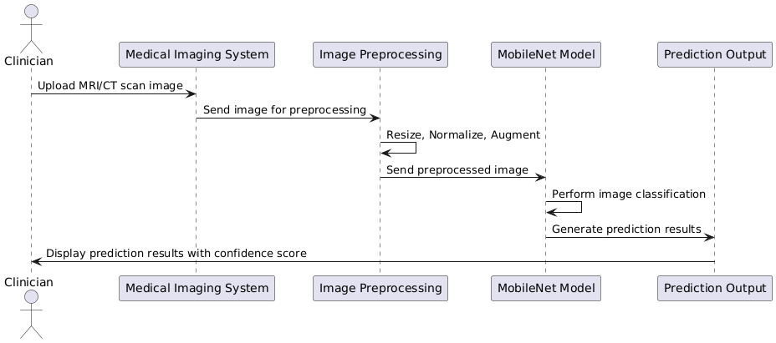
SEQUENCE DIAGRAM

Slide 15
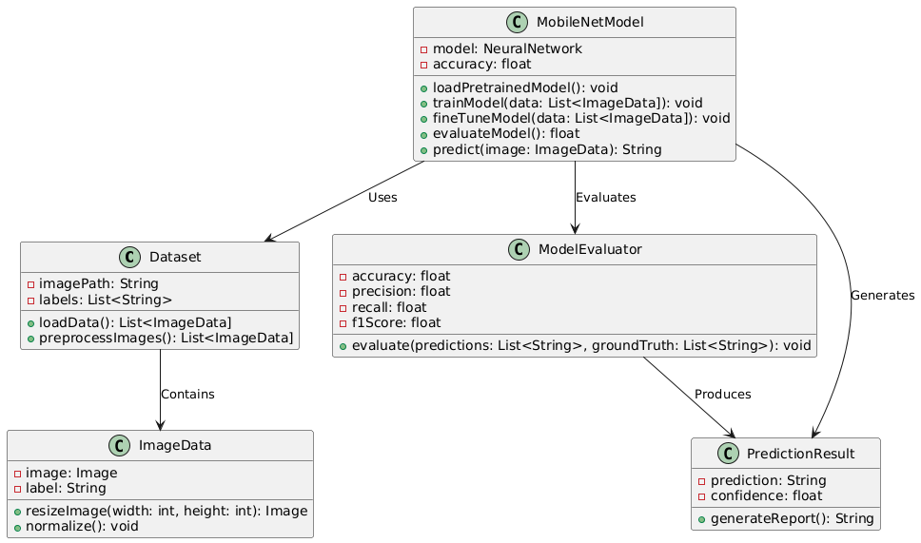
CLASS DIAGRAM

Slide 16
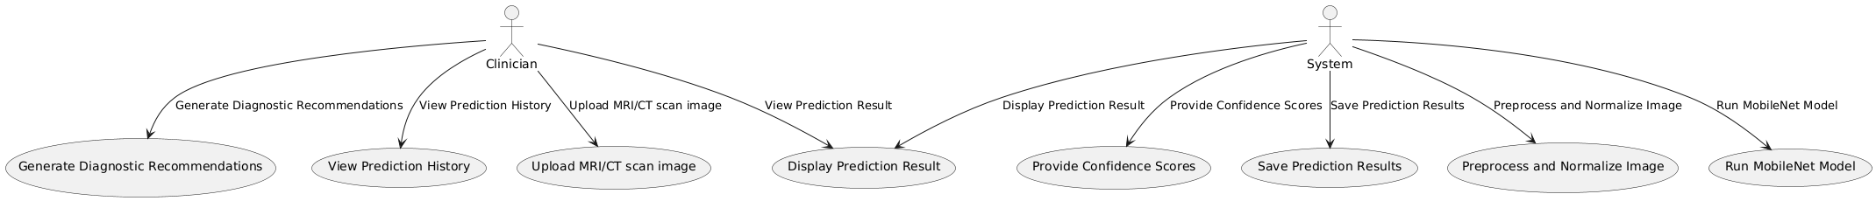
USE CASE DIAGRAM

Slide 17
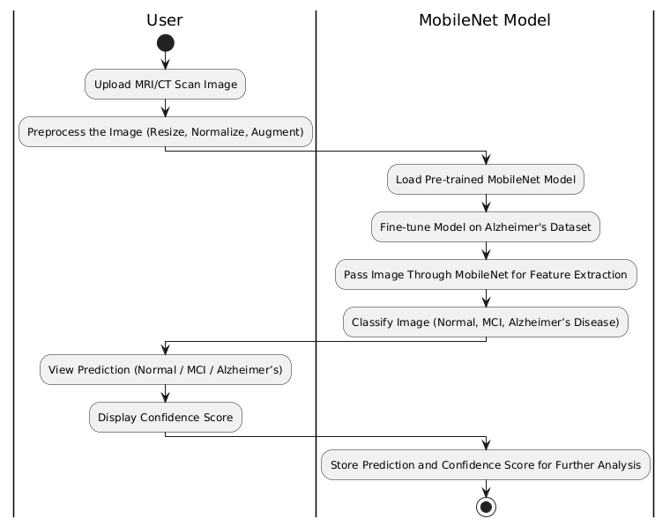
ACTIVITY DIAGRAM

Slide 18

ADVATAGES
Lightweight and Efficient:
MobileNet is designed to be computationally efficient, making it ideal for running on devices with limited resources, such as smartphones, embedded systems, and edge devices. This allows the system to be deployed in real-world healthcare environments without requiring expensive hardware.
High Performance with Low Latency:
MobileNet provides high accuracy in image classification tasks while maintaining low latency, ensuring that the model can process and analyze medical images quickly. This enables timely diagnosis and quick decision-making, which is crucial in healthcare, especially for early detection of Alzheimer’s disease.
Transfer Learning:
MobileNet allows for transfer learning, where the model is pre-trained on large datasets (e.g., ImageNet) and fine-tuned on specific datasets, such as those for Alzheimer’s disease. This reduces the need for large datasets and extensive training time, improving the overall development process.
97%
ACCURACY

Slide 19


01
02
03
04
DATA COLLECTION
MOBILENET
DEVELOPEMENT
FEATURE
EXTRACTION
TESTING & DEPLOYMENT:
MODULES
Medical imaging datasets containing MRI, CT scans, or other relevant imaging data with labeled Alzheimer’s disease categories (e.g., normal, mild, moderate, severe)
MobileNet is a lightweight CNN architecture designed for mobile and embedded vision applications. It uses depthwise separable convolutions to reduce computation while maintaining accuracy. Key features include: Reduces the number of parameters compared to standard convolutions.
MobileNet extracts high-level features from input images using its depthwise separable convolution layers
The system classifies input images into predefined categories, such as Normal, Mild Cognitive Impairment (MCI), or Alzheimer’s Disease.
Optimize the system for deployment on resource-constrained device.
Develop a simple and intuitive user interface for clinicians to upload images and view results.

Slide 20

HARDWARE
REQUIREMENTS
System : Pentium i3 Processor.
Hard Disk : 20 GB.
Monitor : 15’’ LED
Input Devices : Keyboard, Mouse
Ram : 4 GB

Slide 21
SOFTWARE
REQUIREMENTS
Operating system : Windows, MAC OS
Coding Language : Python, HTML, CSS,JS
Web Framework : Flask

Slide 22


CONCLUSION
The development of an Alzheimer’s disease prediction system using the MobileNet algorithm offers a promising solution for early detection and diagnosis of this neurodegenerative disorder.
Through the use of MobileNet’s lightweight and efficient deep learning architecture, the system provides a highly effective method for analyzing medical imaging data, such as MRI or CT scans, with minimal computational requirements.
This makes it ideal for deployment on mobile devices and resource-constrained environments, ensuring accessibility for clinicians in various healthcare settings.
The system is designed to deliver accurate and timely predictions, classifying images into categories such as Normal, Mild Cognitive Impairment (MCI), or Alzheimer’s Disease. By integrating this AI-powered diagnostic tool into clinical workflows.

Slide 23
REFERENCE
[1] B. Sridevi and E. Anupriya, “Machine learning and deep learning algorithms used to diagnosis of Alzheimer’s: Review”, Materials Today: Proceedings 47,2018.
[2] N. Mahendran, P.M.D.R Vincent, K. Srinivasan and C.Y. Chang, “Improving the Classification of Alzheimer's Disease Using Hybrid Gene Selection Pipeline and Deep Learning”, Front Genet.;12 :784814, 2021.
[3] M. T. Abed, U. Fatema, S. A. Nabil, M. A. Alam and M. T. Reza, "Alzheimer's Disease Prediction Using Convolutional Neural Network Models Leveraging Pre-existing Architecture and Transfer Learning," 2020 Joint 9th International Conference on Informatics, Electronics & Vision (ICIEV) and 2020 4th International Conference on Imaging, Vision & Pattern Recognition (icIVPR), pp. 1-6, 2020
[4] P. Deekshitha and M. Nuwan,” A Comparative Study of Alzheimer’s Disease Classification using Multiple Transfer Learning Models”, Journal of Multimedia Information System, Vol. 6, NO. 4, pp. 209 216, 2019.
[5] K. Oh, Y.C.Chung and K.W. Kim, “Classification and Visualization of Alzheimer’s Disease using Volumetric Convolutional Neural Network and Transfer Learning. Sci Rep 9, 2019.

